Slide 1
Within host Models for Dynamics of Malaria Parasites
Sompob Saralamba

Slide 2
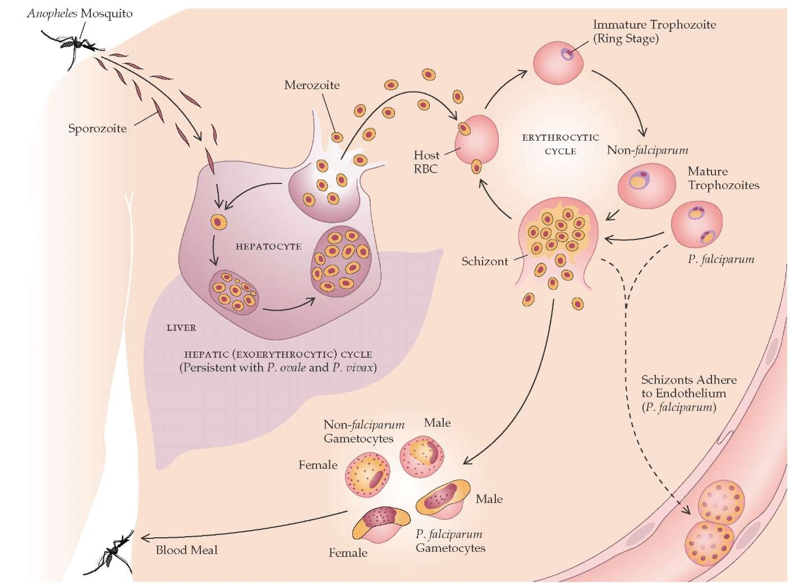
Malaria Parasite Life cycle
Main species to cause malaria in humans
P. falciparum
P. vivax
P. ovale
P. malariae
P. knowlesi
Image from http://what-when-how.com/acp-medicine/protozoan-infections-part-1/

Slide 3
Aspects of within host dynamics
Species
Sporozoites
Liver stage
Asexual stage : Rings, Trophozoites, Schizonts
Merozoites
Sexual stage: Gametocytes
Immunity
Fever
Drugs
Drugs resistance
Anemia
??

Slide 4
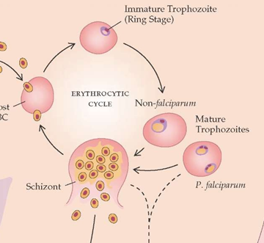
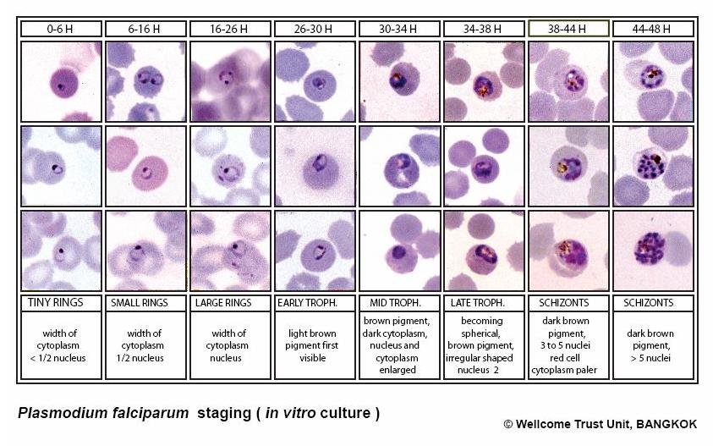
Mechanisms: Asexual development in Plasmodium falciparum
Circulating
Sequestered

Slide 5

Observation: Parasite Count Data
Thin Film
$$\frac{count}{1000RBC}×HCT×125.6$$
Thick Film
$$\frac{count}{200WBC}×40$$
number of parasites per μL
- 1 μL of blood ≈ 12,560,000 RBCs
number of parasites per μL
- average WBC per μL = 8000
Total Peripheral blood parasites = Peripheral blood parasite count × 80,000 × body weight
assume a total blood volume of 80 mL/kg

Slide 6
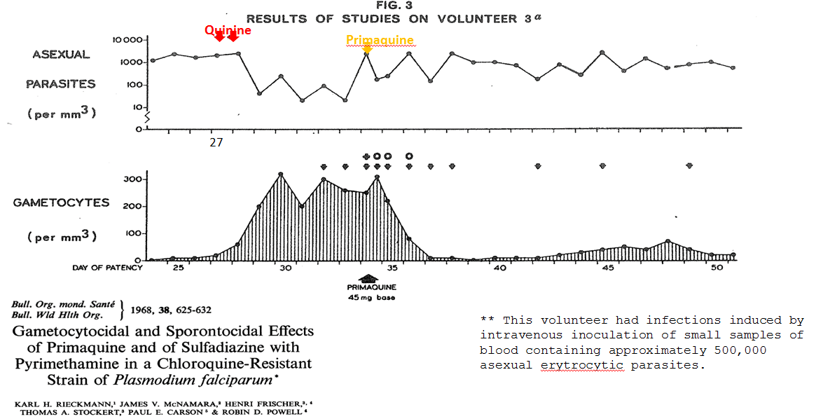
Examples of Parasite Count Data

Slide 7
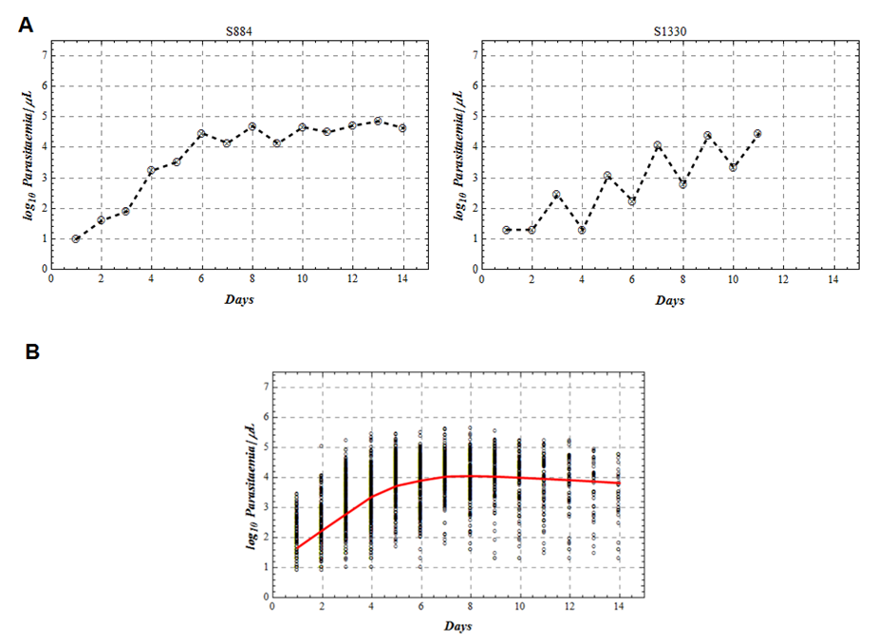
Examples of Parasite Count Data
Ref. ??

Slide 8
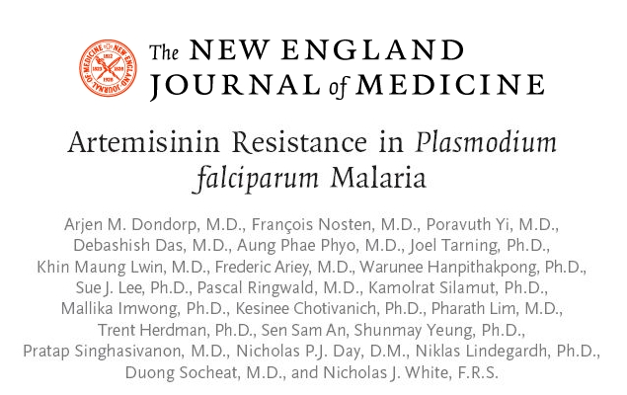
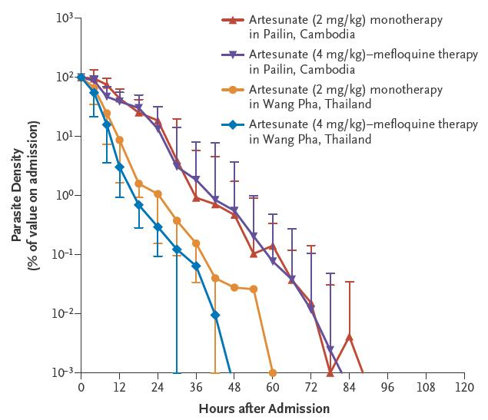
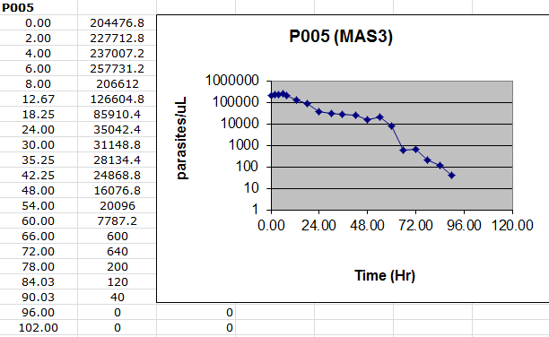
Examples of Parasite Count Data
N Engl J Med, 2009. 361(5): p. 455-67

Slide 9
Within host models for the dynamics of malaria parasites
Statistical model
Simple ODE mechanistic
Simple mechanistic

Slide 10
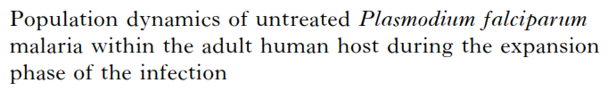
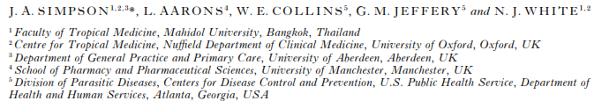

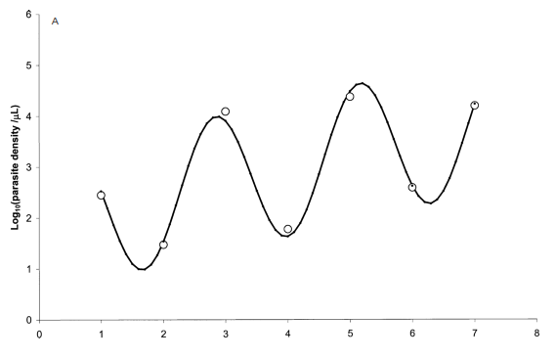
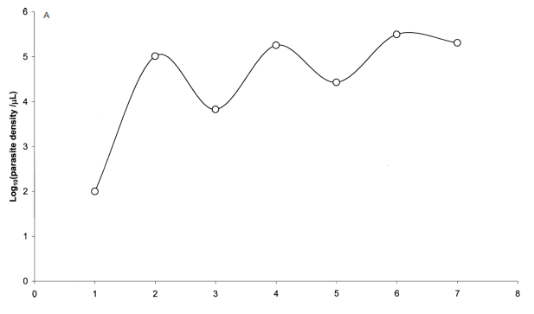
Statistical
can be fitted
cannot be fitted

Slide 11
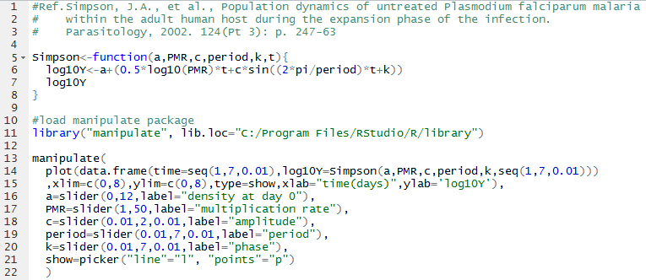
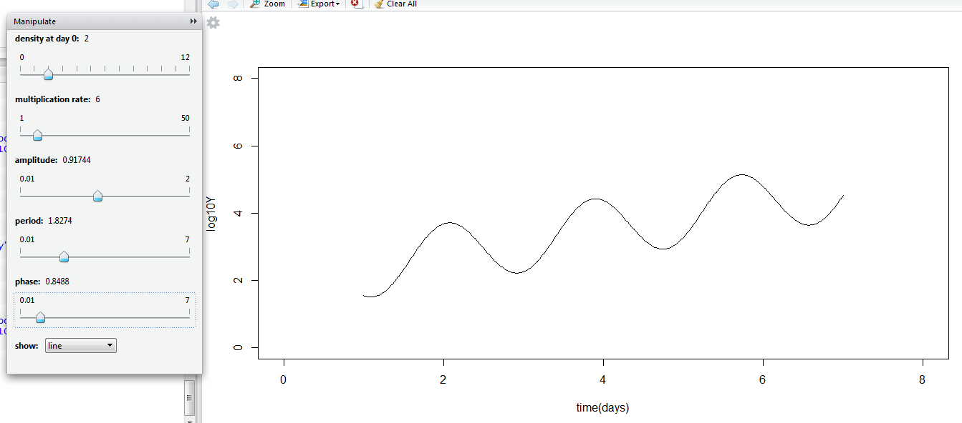
Simpson.R

Slide 12

Simple ODE mechanistic
I
II
III
Uninfected RBCs
Uninfected RBCs
Uninfected RBCs
Infected RBCs
Infected RBCs
Infected RBCs
Merozoites
Merozoites
T Cells
Merozoites
T Cells

Slide 13
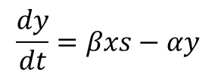
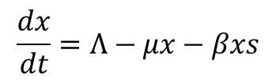
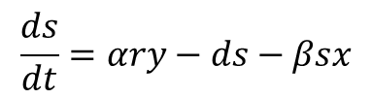
I
Simple ODE mechanistic
Uninfected RBCs
$$\frac{dx}{dt}=Λ−μx−βxs$$
Infected RBCs
$$\frac{dy}{dt}=βxs−αy$$
Merozoites
$$\frac{ds}{dt}=αry−ds−βsx$$

Slide 14
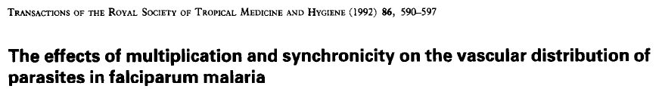
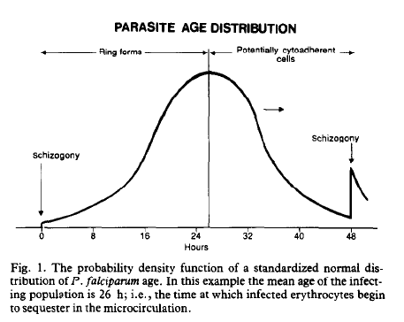
Simple mechanistic
x PMF
Equations ??

Slide 15
Practices
Write NJW model in R
Visualise the output
Define a goodness of fit metric
Compare with data “visually”
Estimate parameters (formally)

Slide 16
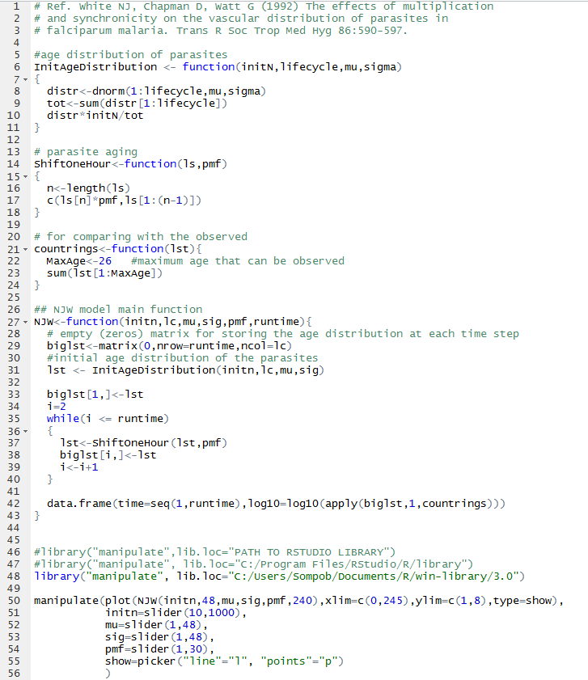
NJW.R

Slide 17
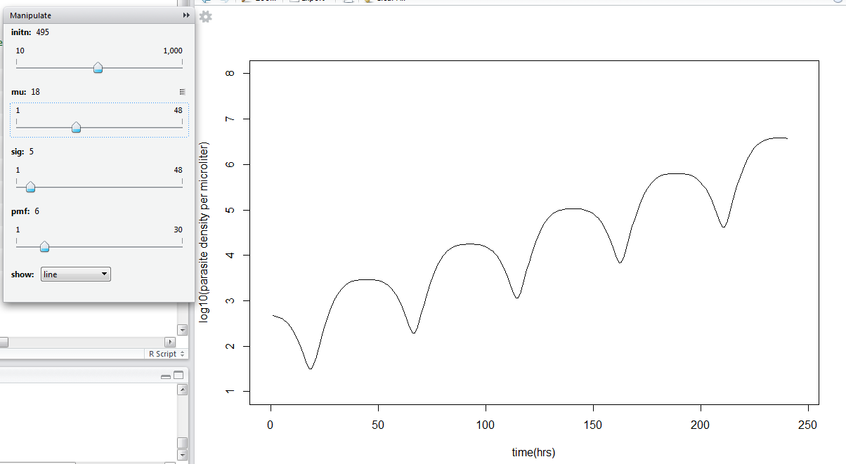
NJW.R

Slide 18
Goodness of fit

Slide 19
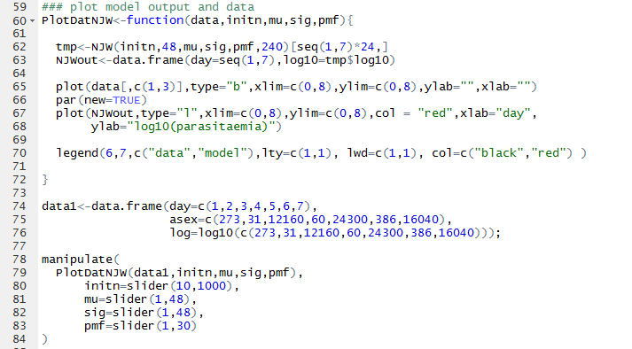
Visualisation
NJW.R

Slide 20
Parameter Estimation

Slide 21
Plateau
Switching to gamtocytes
Immunity
Fever
Other???
Practical modify R code to fit new long dataset
In groups: each group will present results (5 mins)

Slide 22
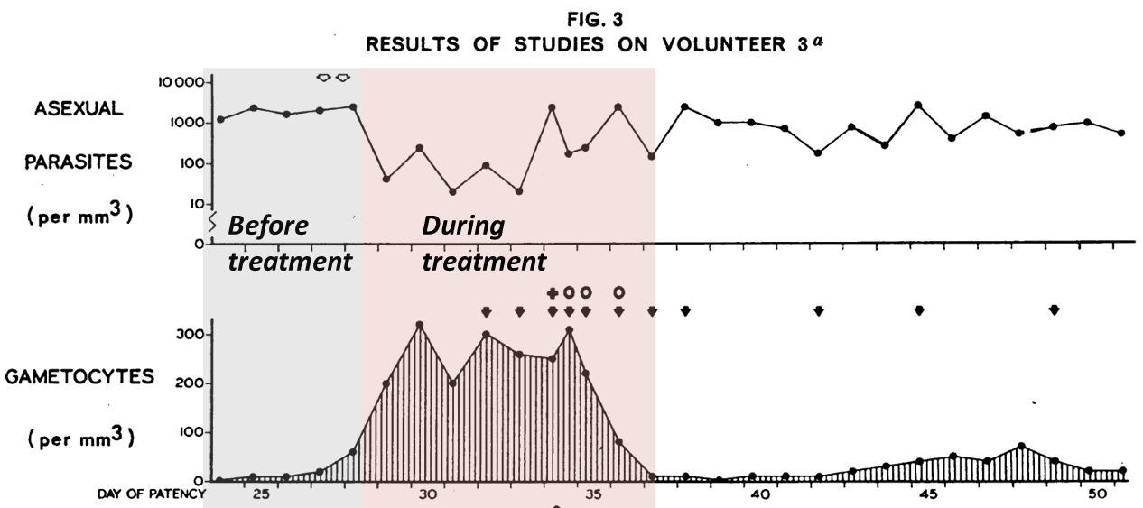

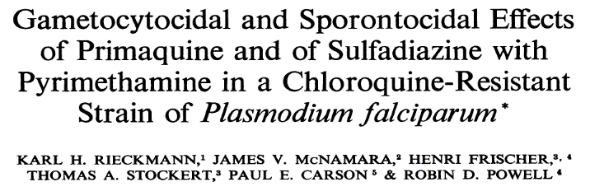
Still to do…

Slide 23
Our models depends on the questions
Why did parasite clear slowly in Pailin under Artesunate treatment?
Reduced killing of rings
Dormancy
Why do parasite counts plateau?

Slide 24
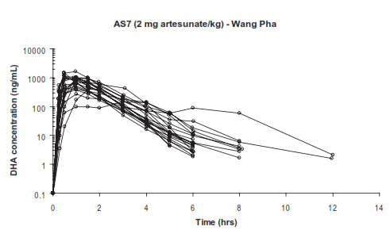
Artemisinin resistance data
two study sites at Wang Pha (TH) and Pailin (KH)
In each site, the patients were divided into two groups for different does regimens, AS7 and MAS3
AS7-2mg/kg per day of artesunate for 7 days
MAS3 – artesunate 4 mg/kg per day for 3 days followed by mefloquine 15 mg/kg on day 3 and 10 mg/kg on day 4
Parasitaemia was assessed on admission, 4, 8 and 12 hrs after start of antimalarial treatment and then every 6 hrs until 2 consecutive slides were negative.
Plasma concentrations of Dihydroartemisinin (DHA) were taken at 15 and 30 min, 1, 1.5, 2, 3, 4, 5, 6, 8 and 12 hrs after the first dose.

Slide 25
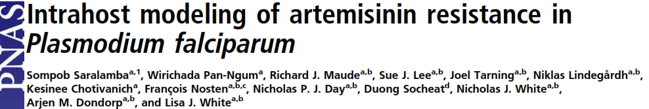
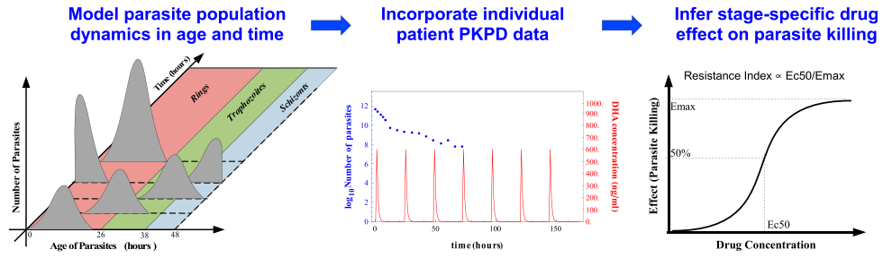
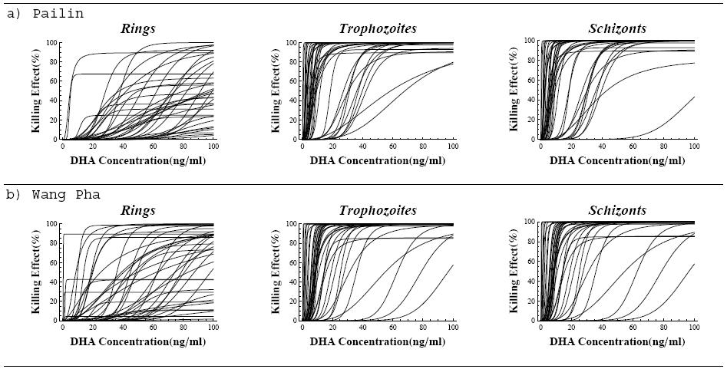
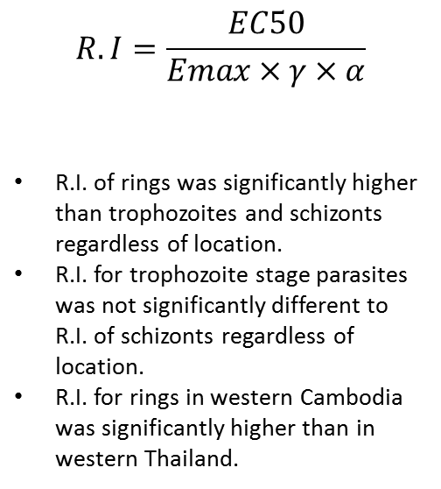
Mechanistic multi-stage
$$R.I=\frac{EC50}{Emax×γ×α}$$
R.I. of rings was significantly higher than trophozoites and schizonts regardless of location.
R.I. for trophozoite stage parasites was not significantly different to R.I. of schizonts regardless of location.
R.I. for rings in western Cambodia was significantly higher than in western Thailand.

Slide 26
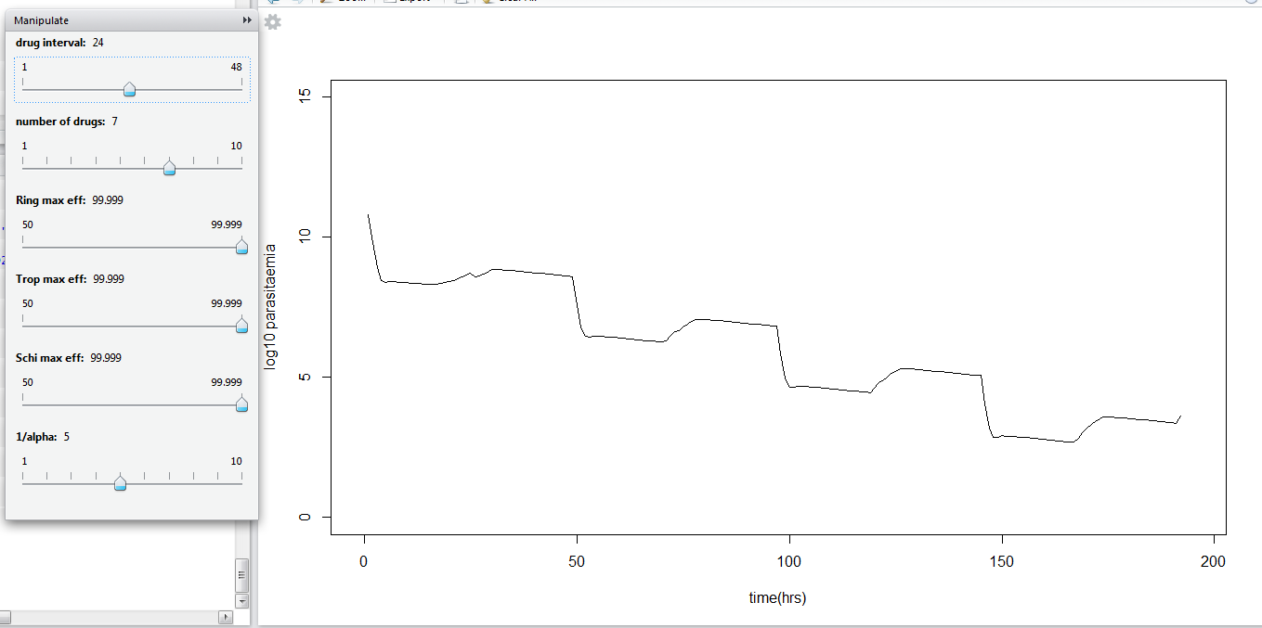
Sompob.R

Slide 27
Practical sliders MS -> PL
Fit to MS
Change ring killing to fit to Pailin
Is there any other way to MS->PL?

Slide 28
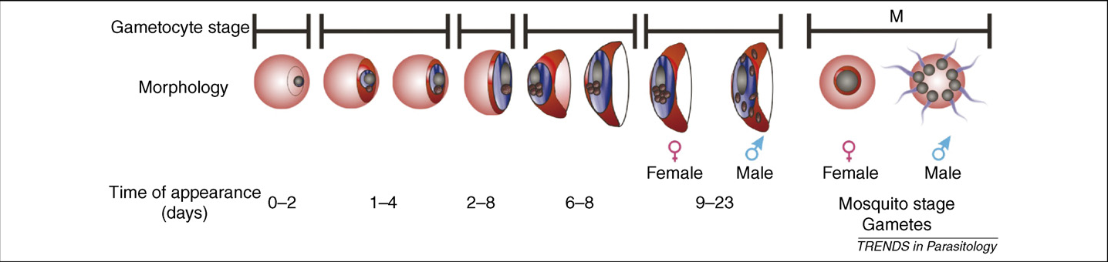
Sexual development in Plasmodium
Circulating
Sequestered
Circulating

Slide 29
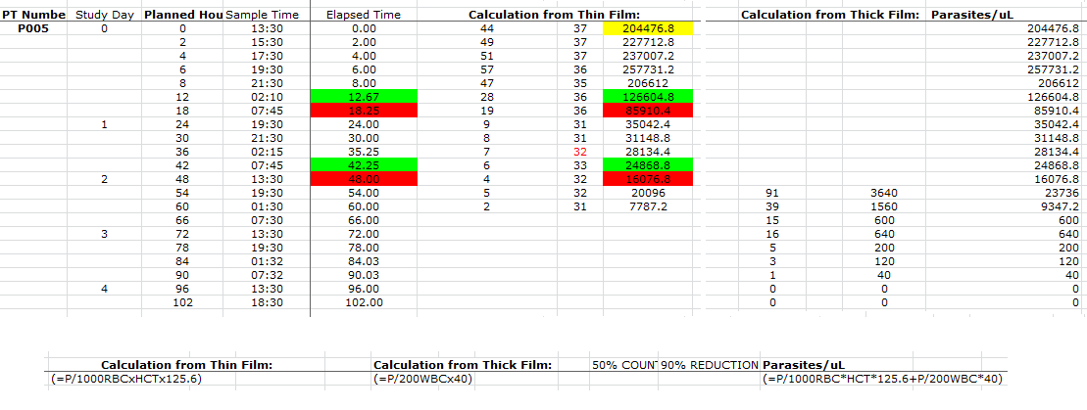
Example of raw data from the artemisinin resistance study

